Slide 1
Math Basics
Linear Algebra
Probability
Information Theory

Slide 2
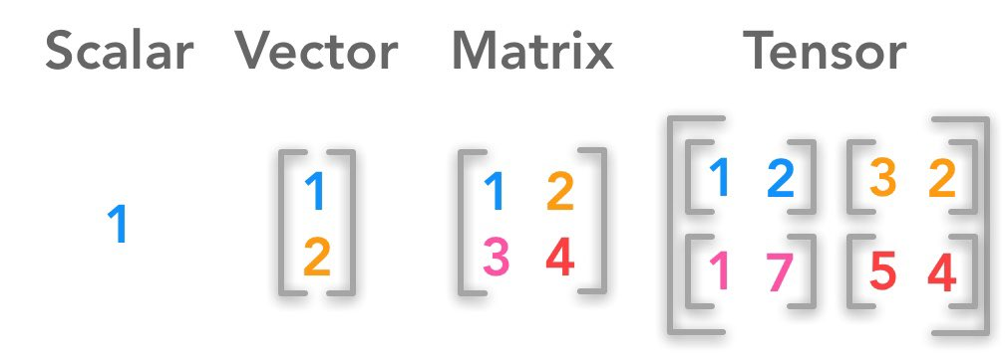




Linear Algebra
$$x ε R$$
$$x ε R^{n}$$
$$A ε R^{m×n}$$
$$A ε R^{n_{1}×n_{2}….×n_{k}}$$

Slide 3
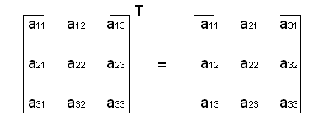
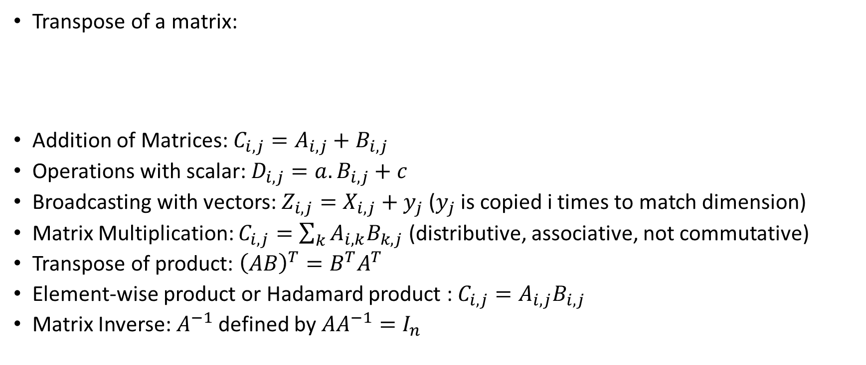
Linear Algebra
Transpose of a matrix:
Addition of Matrices: $C_{i,j}=A_{i,j}+B_{i,j}$
Operations with scalar: $D_{i,j}=a. B_{i,j}+c$
Broadcasting with vectors: $Z_{i,j}=X_{i,j}+y_{j}$ ($y_{j}$ is copied i times to match dimension)
Matrix Multiplication: $C_{i,j}=\sum_{k}{A_{i,k}B_{k,j}}$ (distributive, associative, not commutative)
Transpose of product: ${\left(AB\right)}^{T}=B^{T}A^{T}$
Element-wise product or Hadamard product : $C_{i,j}=A_{i,j}B_{i,j}$
Matrix Inverse: $A^{−1}$ defined by $AA^{−1}=I_{n}$

Slide 4
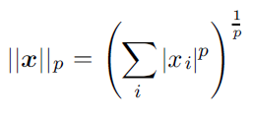
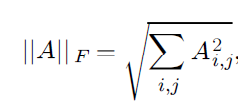
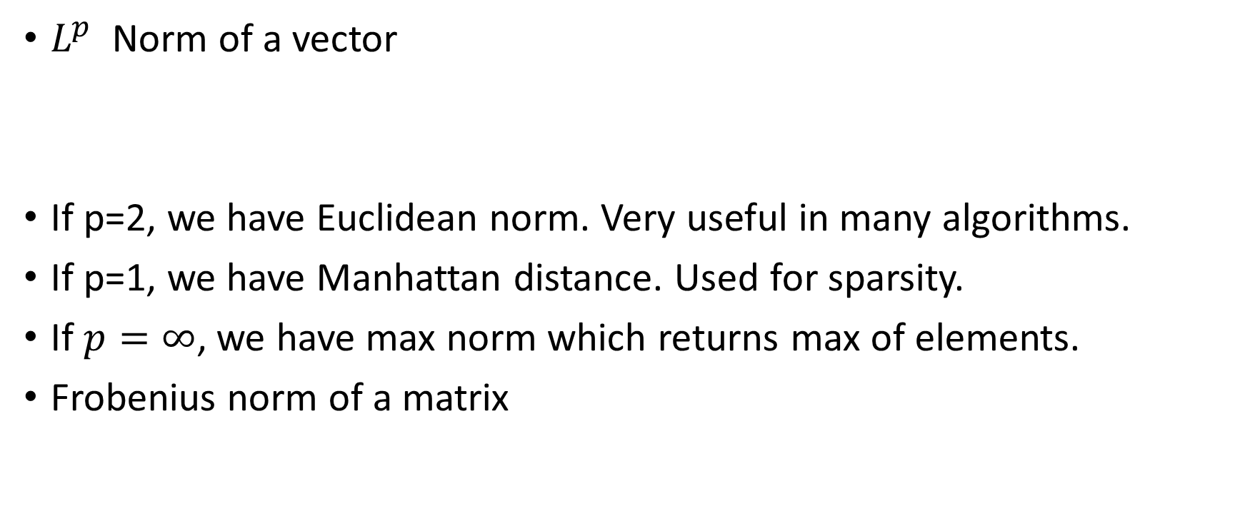
Linear Algebra
$L^{p}$ Norm of a vector
If p=2, we have Euclidean norm. Very useful in many algorithms.
If p=1, we have Manhattan distance. Used for sparsity.
If $p=∞$, we have max norm which returns max of elements.
Frobenius norm of a matrix

Slide 5
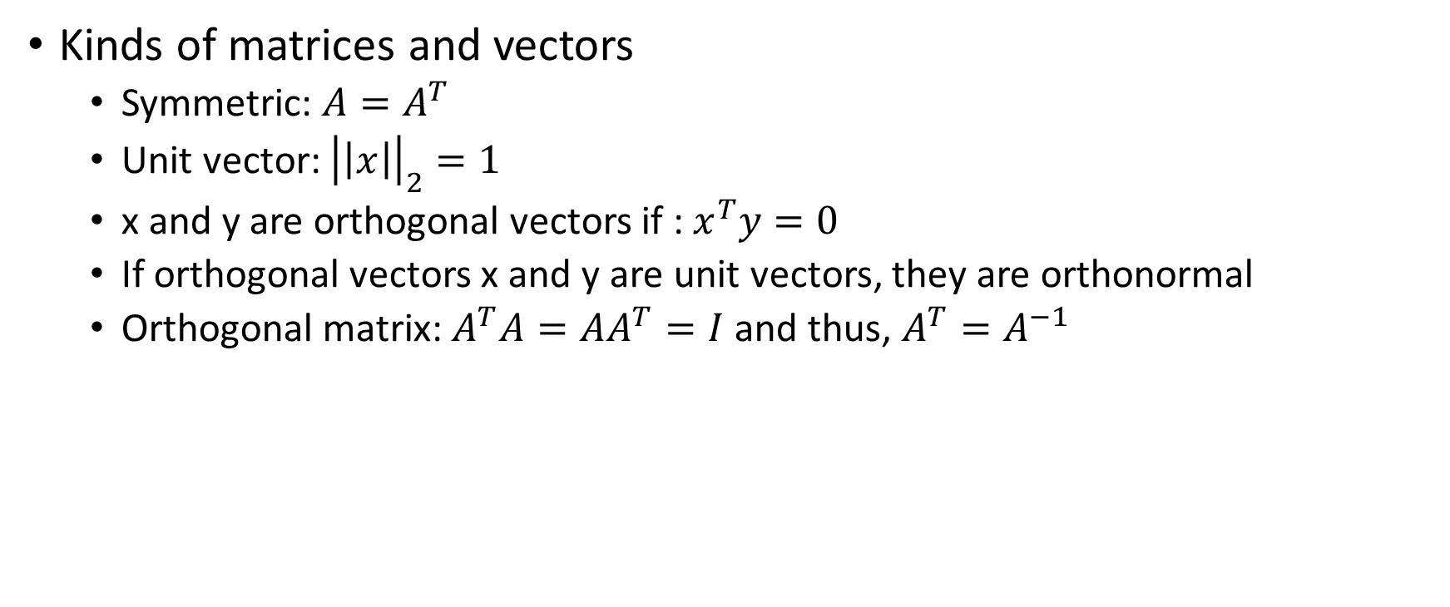
Linear Algebra
Kinds of matrices and vectors
Symmetric: $A=A^{T}$
Unit vector: ${\left|\left|x\right|\right|}_{2}=1$
x and y are orthogonal vectors if : $x^{T}y=0$
If orthogonal vectors x and y are unit vectors, they are orthonormal
Orthogonal matrix: $A^{T}A=AA^{T}=I$ and thus, $A^{T}=A^{−1}$

Slide 6
Probability
Quantifying uncertainty.
Used in designing and analyzing AI algorithms.
Sources of uncertainty:
Inherent stochasticity: Eg – shuffling in a card
Incomplete observability: When we don’t observe all variables driving a system. Eg: Look up Monty Hall problem
Incomplete modeling: When a model discards certain information.
Frequentist probability. Eg: Coin toss has probability 0.5 implies if we repeat the toss infinitely many times, then 50% of the repetitions turn heads.
Bayesian probability – degree of belief. Eg: Patient survival is 60% does not imply we have replicas of the patient.

Slide 7


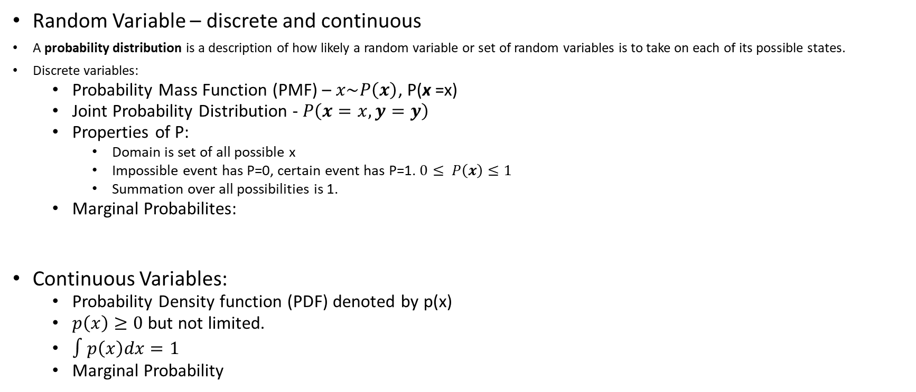
Probability
Random Variable – discrete and continuous
A probability distribution is a description of how likely a random variable or set of random variables is to take on each of its possible states.
Discrete variables:
Probability Mass Function (PMF) – $x\sim P\left(x\right)$, P(x =x)
Joint Probability Distribution - $P\left(x=x, y=y\right)$
Properties of P:
Domain is set of all possible x
Impossible event has P=0, certain event has P=1. $0≤ P\left(x\right)≤1$
Summation over all possibilities is 1.
Marginal Probabilites:
Continuous Variables:
Probability Density function (PDF) denoted by p(x)
$p\left(x\right)≥0$ but not limited.
$∫p\left(x\right)dx=1$
Marginal Probability

Slide 8


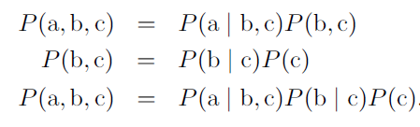
Probability
Conditional Probability
Chain rule
Independent
Conditionally Independent

Slide 9



Probability
Expectation:
Variance:
Covariance:

Slide 10
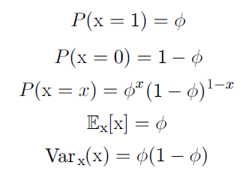

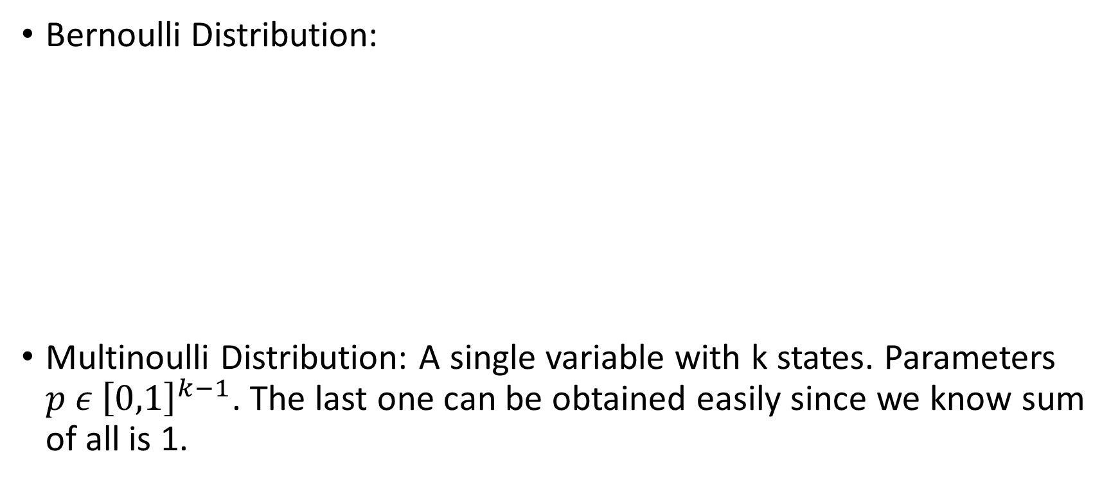
Probability
Bernoulli Distribution:
Multinoulli Distribution: A single variable with k states. Parameters $p ε {\left[0,1\right]}^{k−1}$. The last one can be obtained easily since we know sum of all is 1.

Slide 11

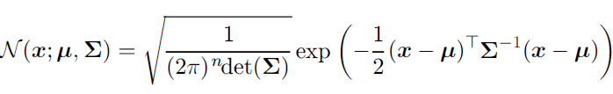

Probability
Gaussian Distribution
Mixture of distributions:
A gaussian mixture model can be used as a universal approximator with enough number of components.

Slide 12


Probability
Central Limit Theorem: Given a sufficiently large sample size from a population with a finite level of variance, the mean of all samples from the same population will be approximately equal to the mean of the population
Bayes Rule

Slide 13
Information Theory
Tries to quantify how much information is present in a signal.
Originally used for optimally coding communication transmissions.
Our interest is quantifying similarity between probability distributions.
Idea: An unlikely event is more informative than a likely event. Eg: “The sun rose today” is less informative than “There was an eclipse this morning.”
Quantifying information:
Likely events have low information content and vice versa.
Independent events should have additive information. Eg: A coin turning heads twice should give twice the information a coin turning heads once.

Slide 14

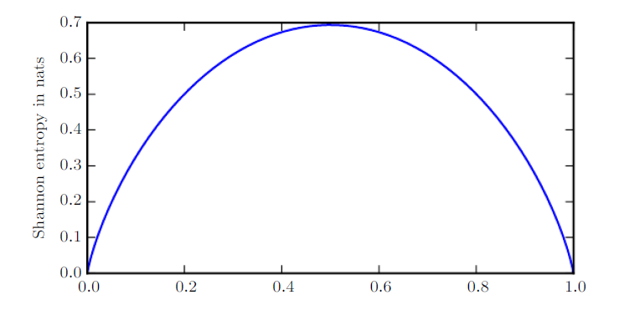
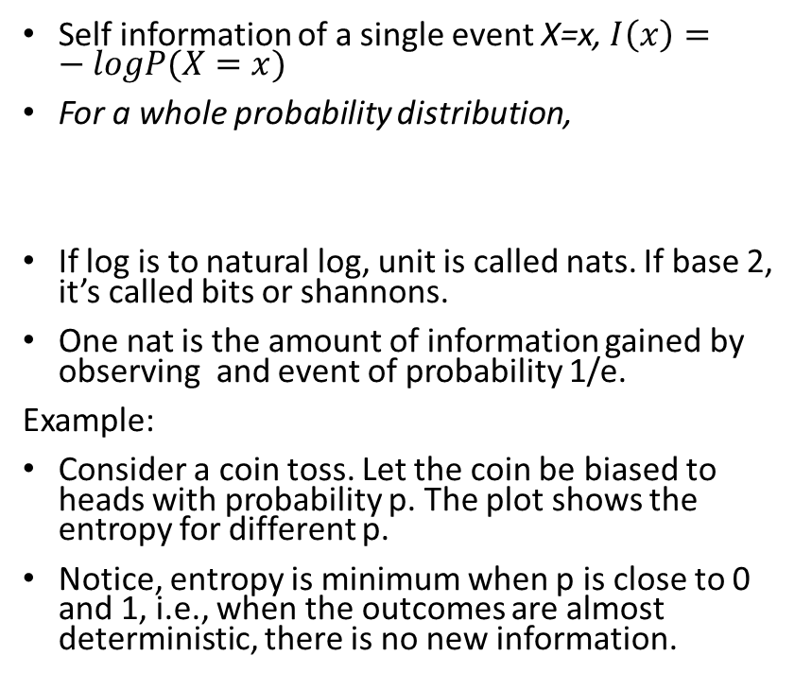
Information Theory
Self information of a single event X=x, $I\left(x\right)=−logP(X=x)$
For a whole probability distribution,
If log is to natural log, unit is called nats. If base 2, it’s called bits or shannons.
One nat is the amount of information gained by observing and event of probability 1/e.
Example:
Consider a coin toss. Let the coin be biased to heads with probability p. The plot shows the entropy for different p.
Notice, entropy is minimum when p is close to 0 and 1, i.e., when the outcomes are almost deterministic, there is no new information.
p

Slide 15

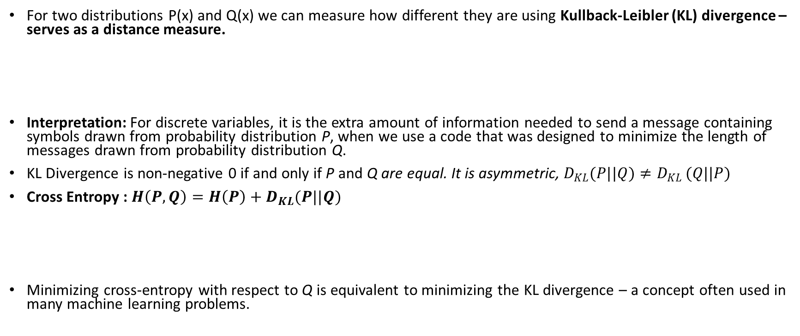
Information Theory
For two distributions P(x) and Q(x) we can measure how different they are using Kullback-Leibler (KL) divergence – serves as a distance measure.
Interpretation: For discrete variables, it is the extra amount of information needed to send a message containing symbols drawn from probability distribution P, when we use a code that was designed to minimize the length of messages drawn from probability distribution Q.
KL Divergence is non-negative 0 if and only if P and Q are equal. It is asymmetric, $D_{KL}(P||Q)≠D_{KL }(Q||P)$
Cross Entropy : $H\left(P,Q\right)=H\left(P\right)+D_{KL}(P||Q)$
Minimizing cross-entropy with respect to Q is equivalent to minimizing the KL divergence – a concept often used in many machine learning problems.

Slide 16
Further Reading
Eigen decomposition
Singular Value Decomposition (SVD)
Calculus
You may read
Deep Learning – Ian Goodfellow (Chapter 2,3,4)
Linear Algebra - Gilbert Strang

Slide 17
Fin.

Slide 18
LinAl outline
Hadamard product
Dot product
Identity, Inverse matrices
+Linear dependence, Span
Norms – triangular inequality,
Diagonal, symmetric, unit vector, orthogonal,orthonormal
Determinant, trace operator
+ eigendecomposition, SVD

Slide 19
Probability Outline
Sources of uncertainty
Frequentist and Bayesian
Random variables
Probability distributions
Discrete variables, PMF
Continuous variables, PDF
Marginal probability, Conditional probability, Chain rule, Independence
Expectation, variance, covariance
Bernoulli, Multinomial, Gaussian (CLT), Exponential, Laplace, Mixture of distro
Bayes rule

